Slide 1
Python Day One -Environment Setting
POHANWU
20190130

Slide 2
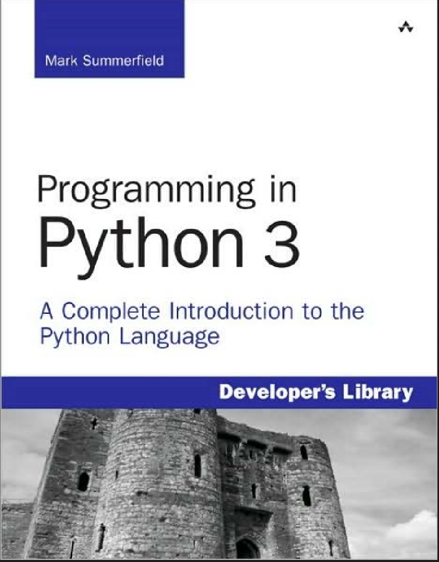
textbook
Link:
https://doc.lagout.org/programmation/python/Programming%20in%20Python%203_%20A%20Complete%20Introduction%20to%20the%20Python%20Language%20%282nd%20ed.%29%20%5BSummerfield%202009-11-22%5D.pdf

Slide 3
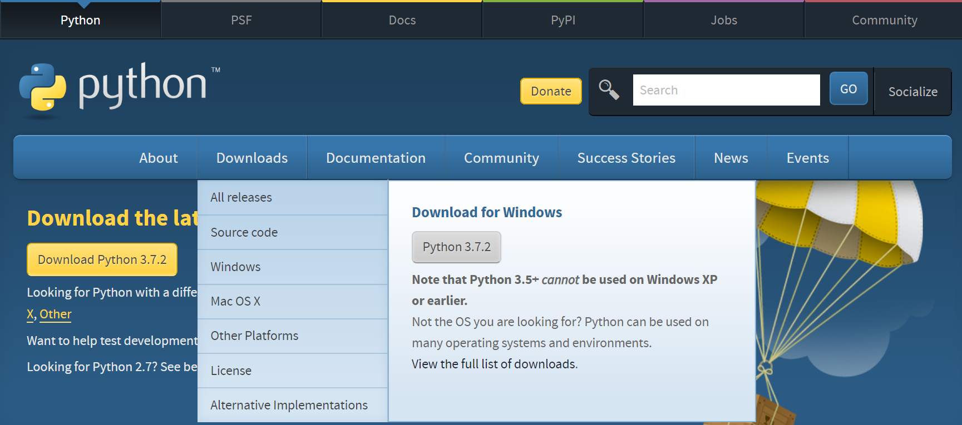
Environment built

Slide 4
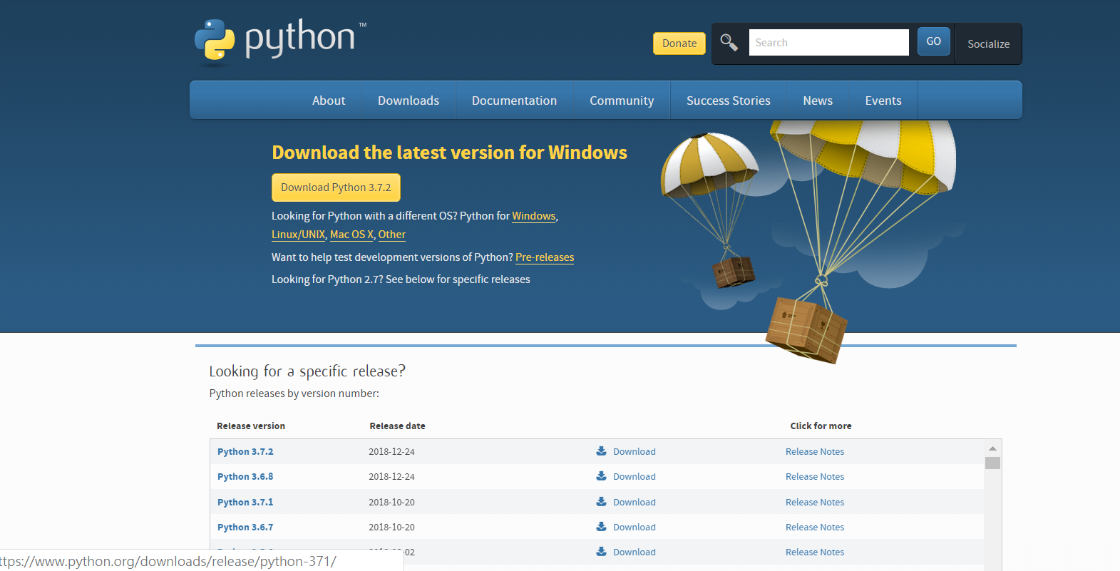
Environment built

Slide 5
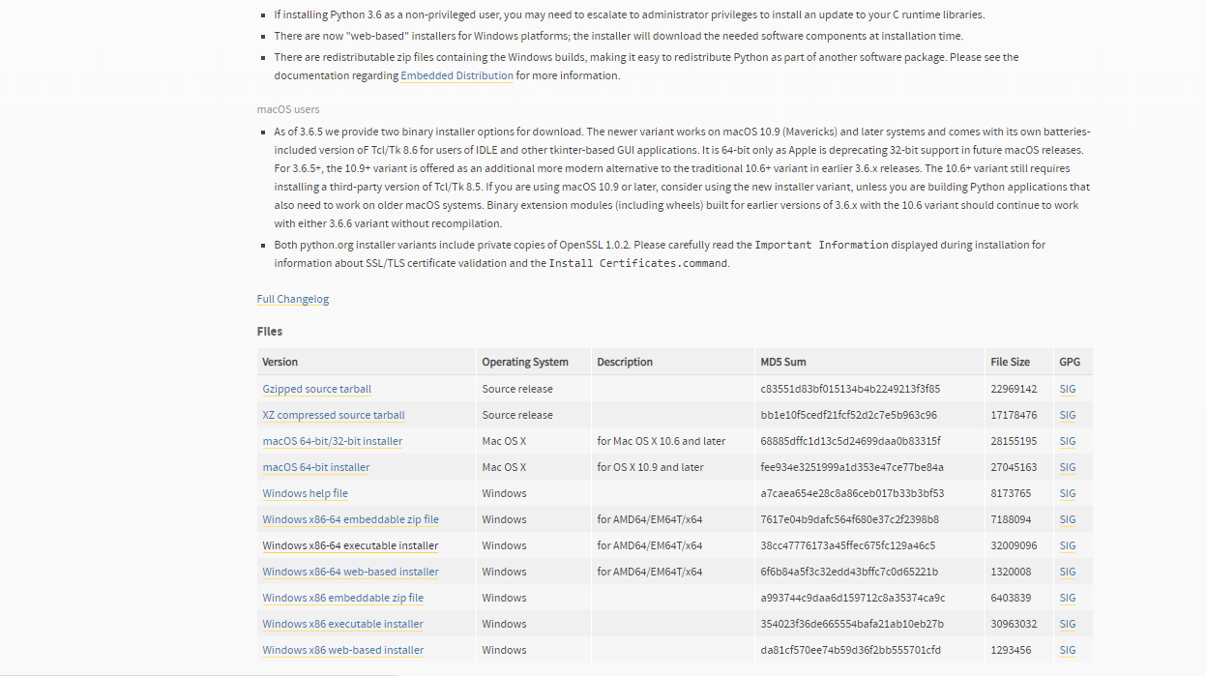
Environment built

Slide 6
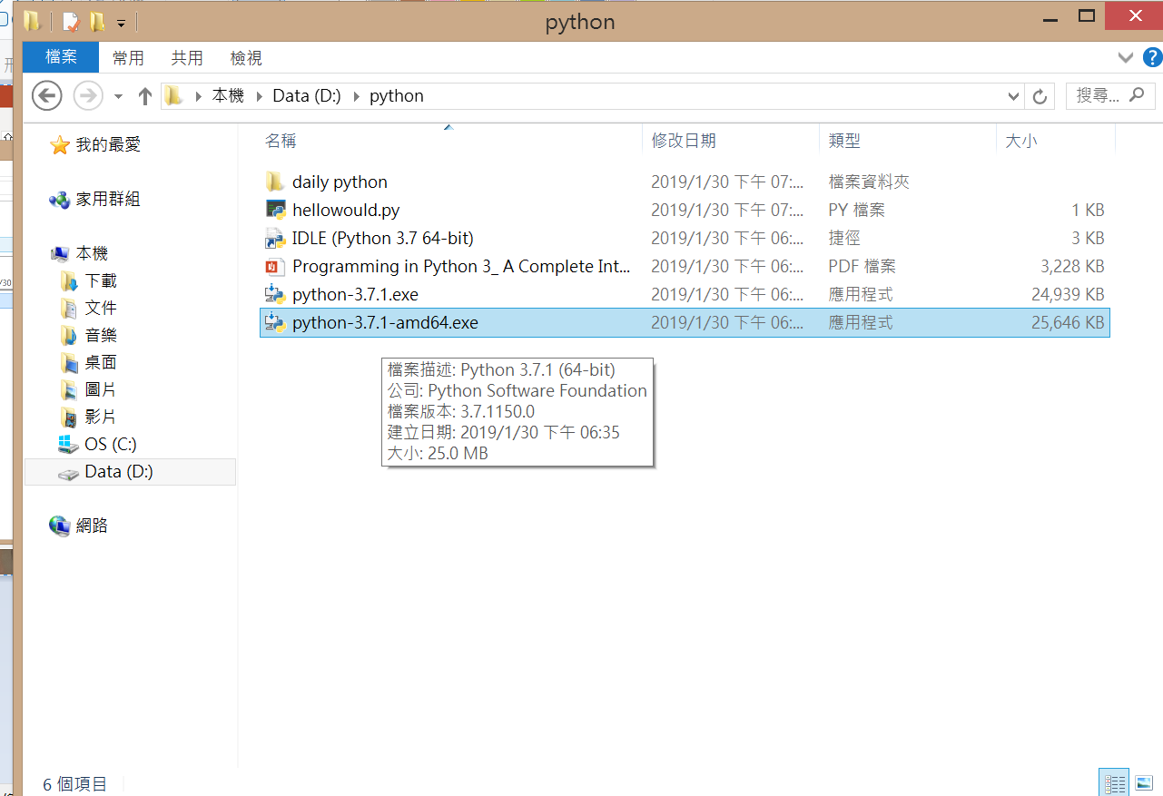
Environment built

Slide 7
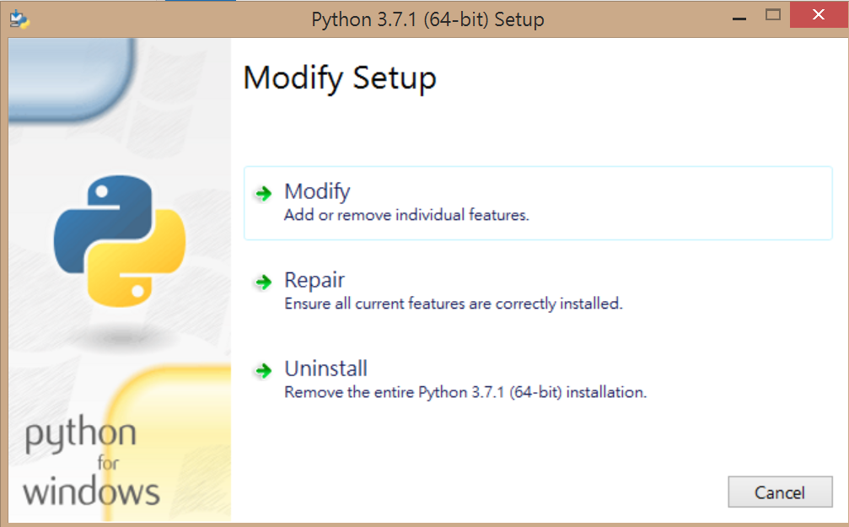
Environment built

Slide 8
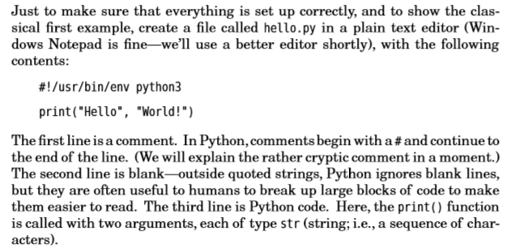
First code page.10

Slide 9
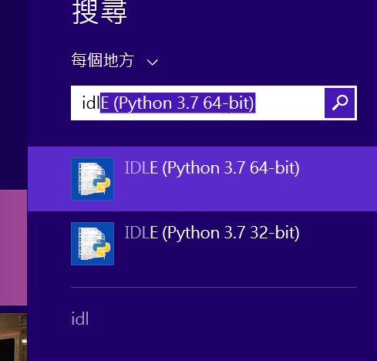
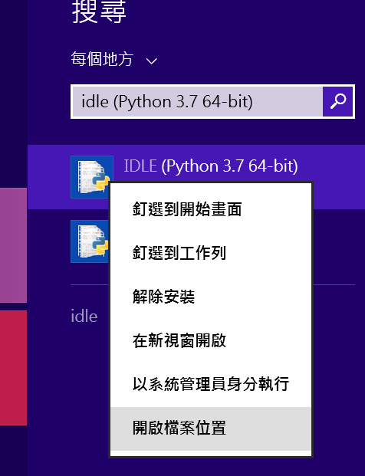
Find (IDLE)Integrated development environment software

Slide 10
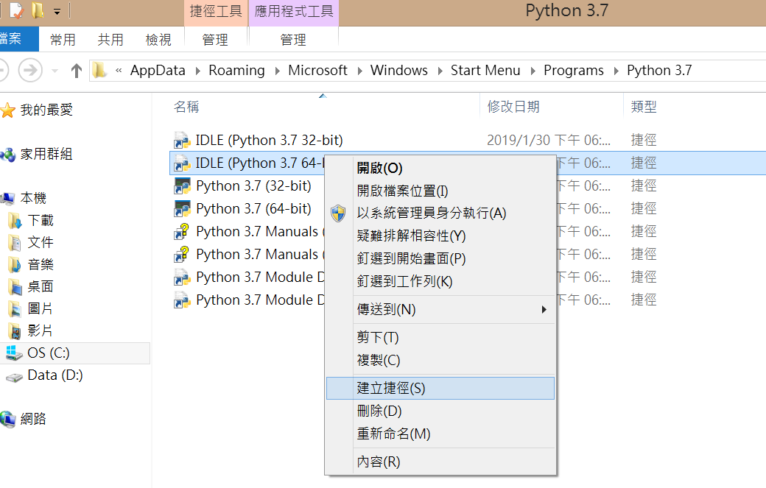
Create shortcut

Slide 11
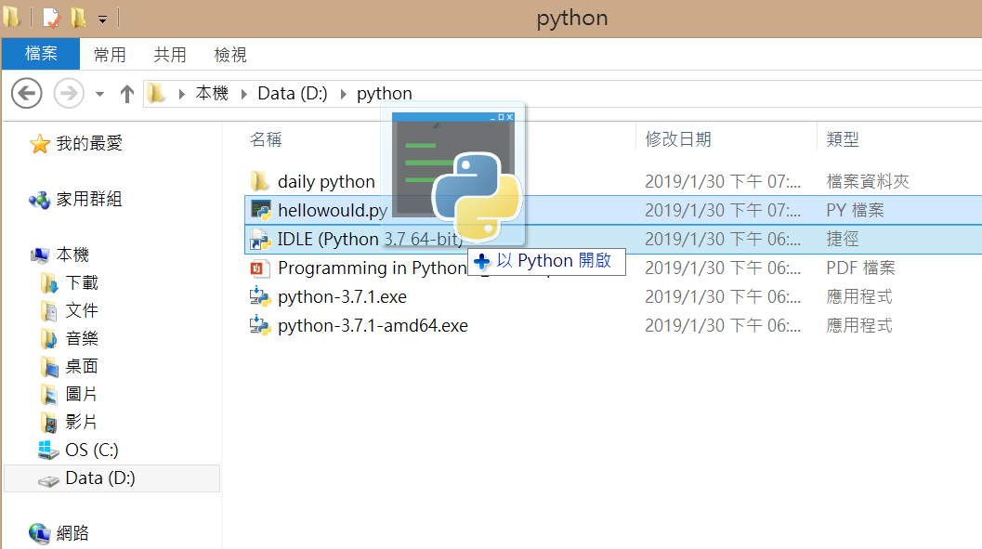
execute

Slide 12
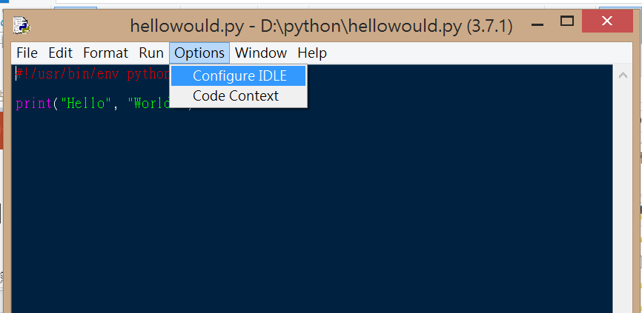
Change configure

Slide 13
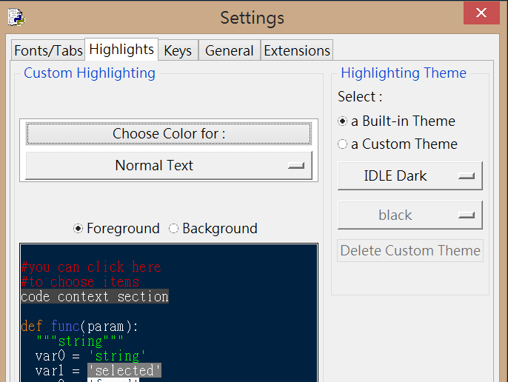
Change configure

Slide 14
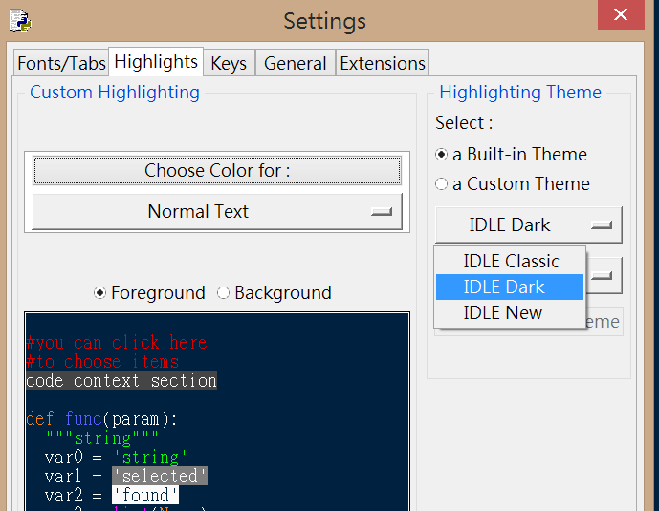
Change configure

Slide 15
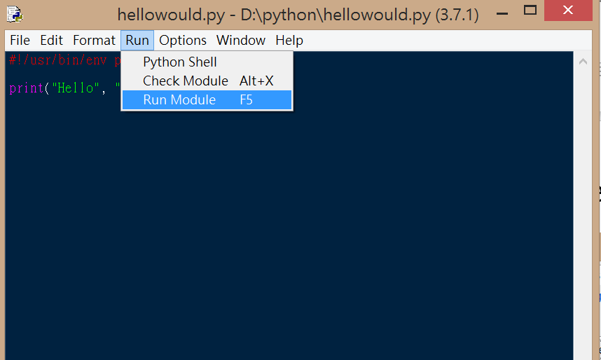
Run module

Slide 16
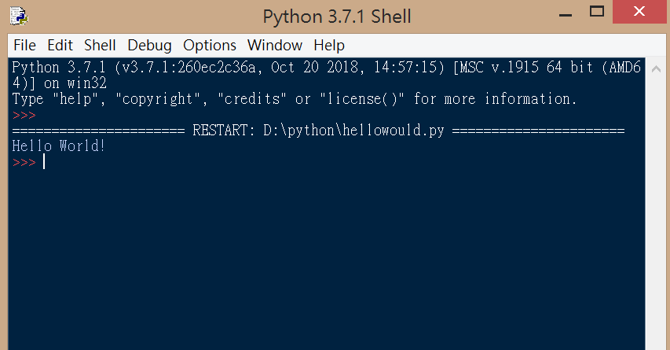
succeed

